Slide 1

A presentation on
Phonebook Mini Project
Course Tilte-Data structure
Course Code-CSE-106

Slide 2
Presented By
Md. Ferdaus Hossen
Id - 221002171

Slide 3
Presented to
Ms.Shamima Akter
Lecturer
Department of Computer Science and Engineering
Faculty of Sciences and Engineering
Green University of Bangladesh

Slide 4
Contents
What is Phonebook?
My project
Daily life usage of this project
Pros of this project
Cons of this project
Future Upgradability

Slide 5
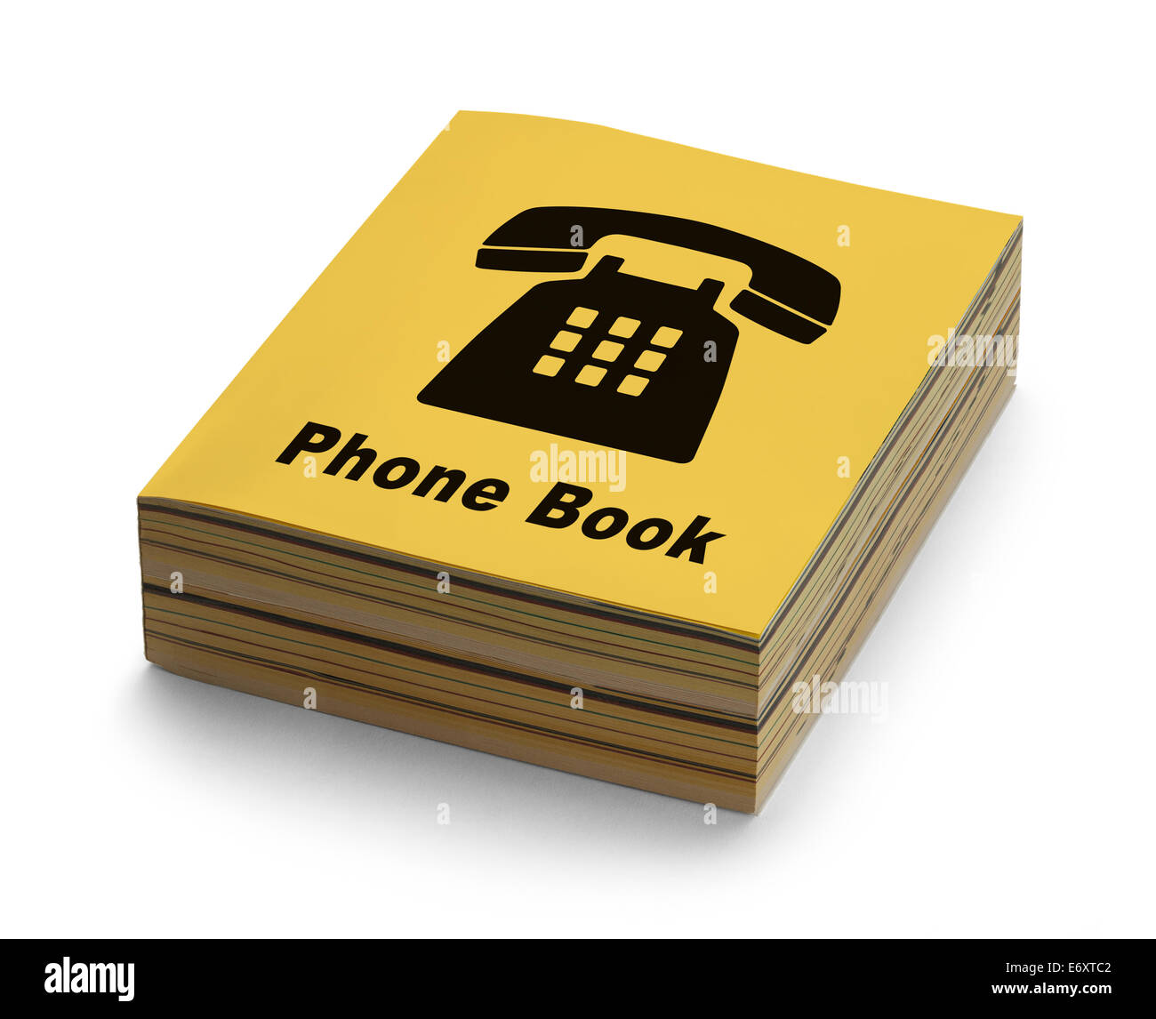
What Is Phonebook?
A book that lists the names, addresses, and phone numbers of the people and businesses in a certain area

Slide 6
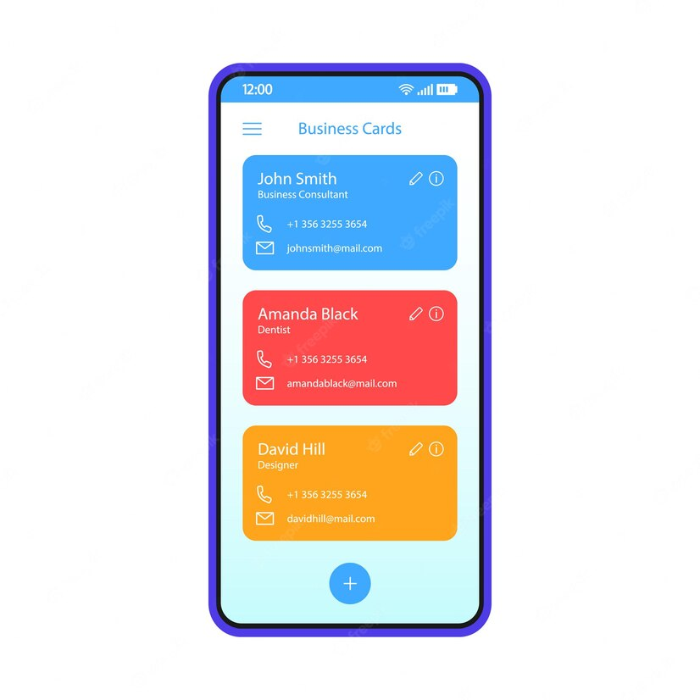
My Project
Digital Phonebook

Slide 7
Daily life usage of this project
People can store contacts
People can search contact
People can remove contact
People can access their stored contacts easily

Slide 8
Pros of this project
Saves Contacts digitally
Prevents Data loss
Reduces paper waste in the environment

Slide 9
Cons of this project
Limitation of storing contacts
Data cannot be retrived if it’s deleted by mistake

Slide 10
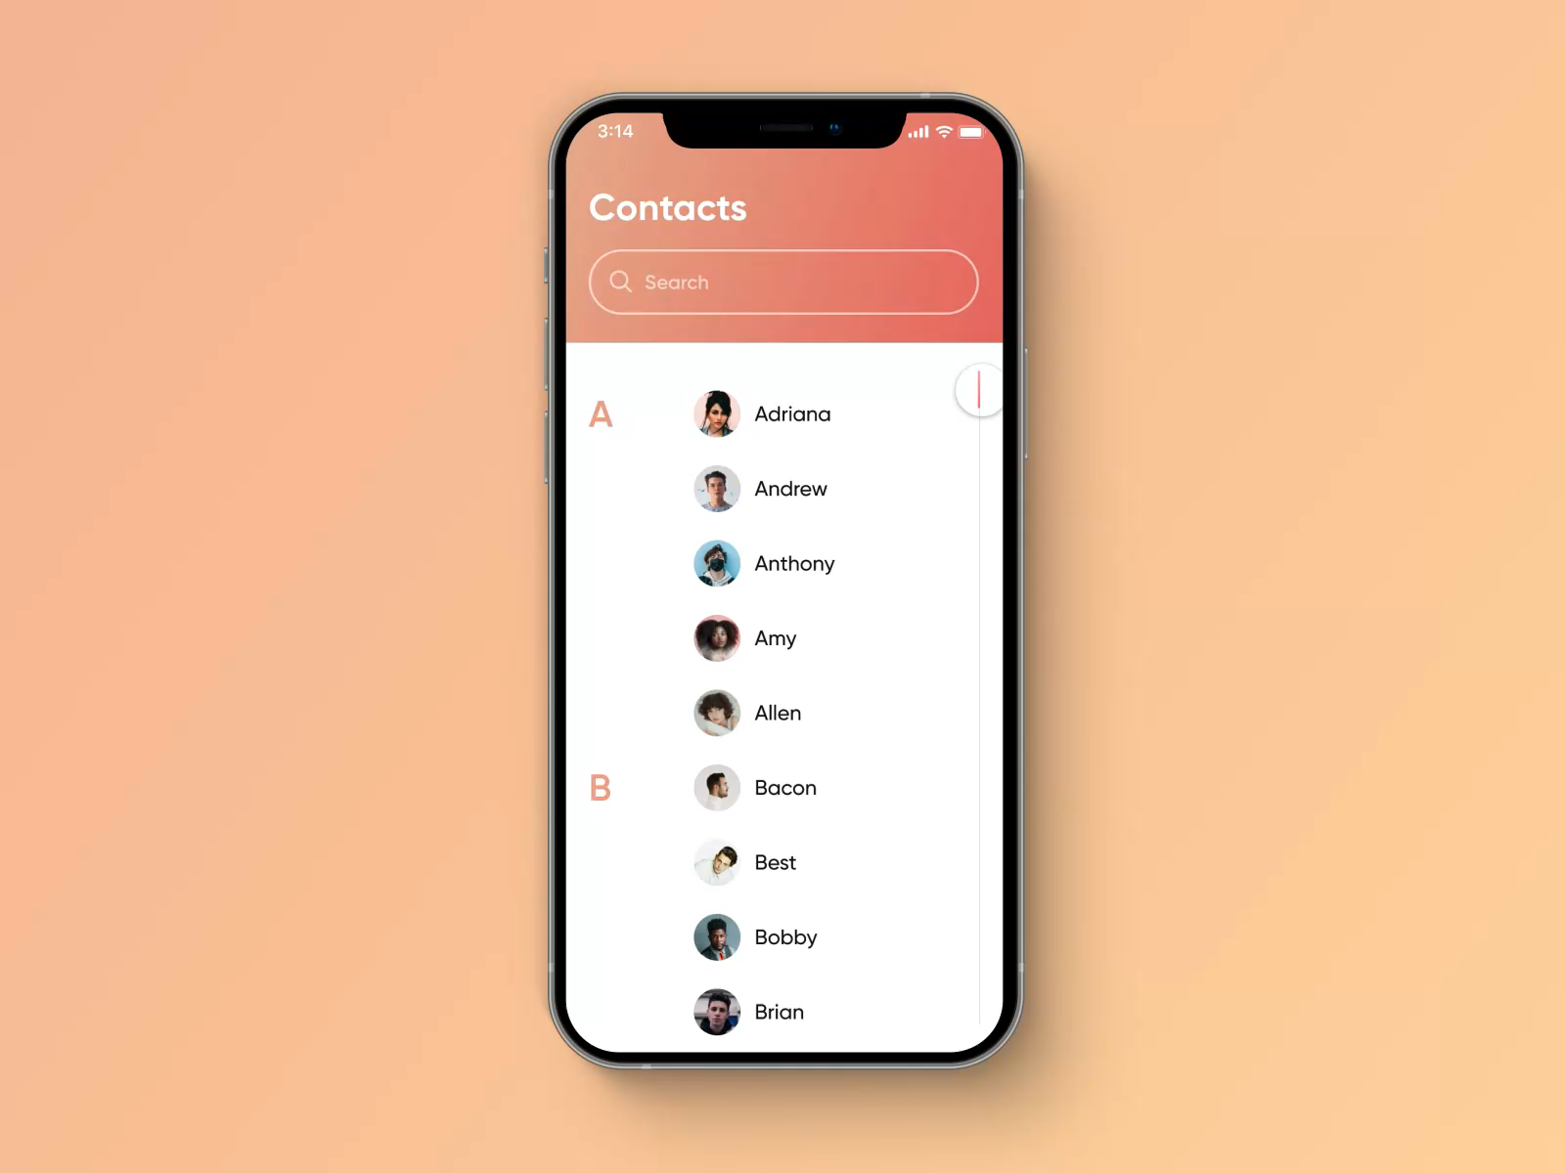
Future Upgradability
GUI(Graphical User Interface)
Add more information to contacts
Implement Networking
Implement Sort contact by many order

Slide 11
Thank you

